Slide 1
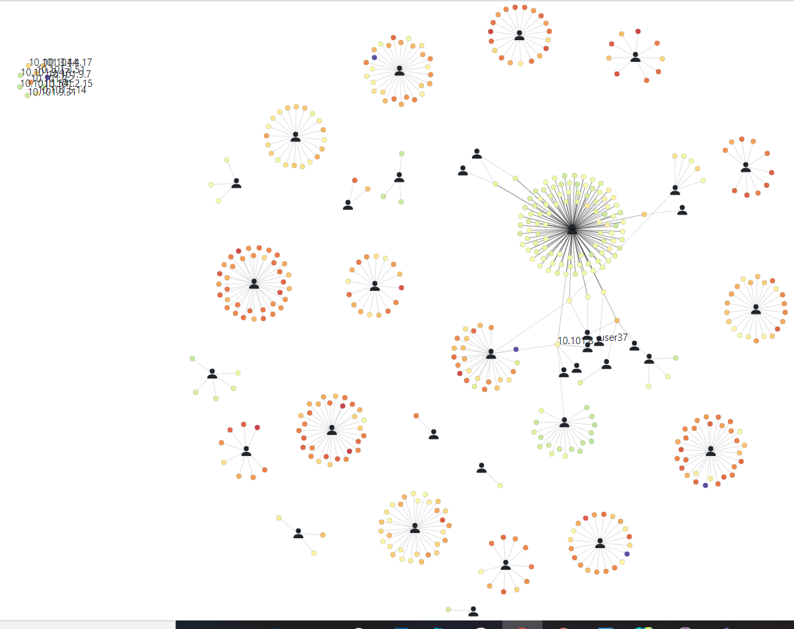
Job Net
Weekly report

Slide 2
Job Net
Compute
User
Link
Color by metrics value (e.g: Temperature, Fan speed, etc.)

Slide 3
Job Net
Compute
User
Link

Slide 4
Job Net
Idle node (no link)
Compute
User
Link
Connect between the user and compute when that user has a running job on that compute. Border thickness related to #jobID

Slide 5
Job Net
Simulated data
https://idatavisualizationlab.github.io/HPCC/jobNet/

Slide 6
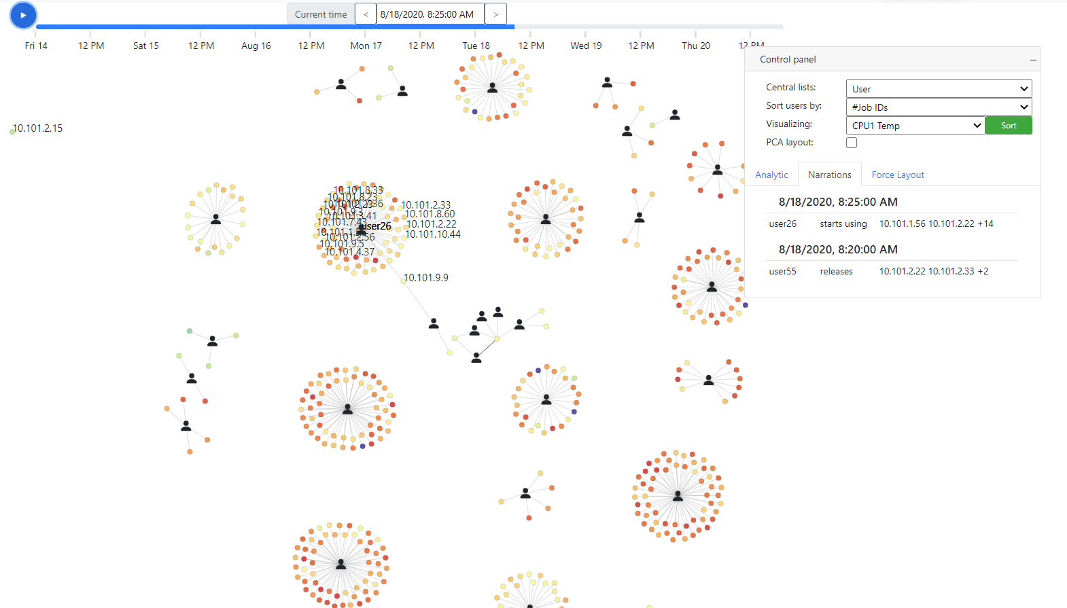
Job Net
Narrations

Slide 7
Job Net
Force layouts | by Metrics

Slide 8
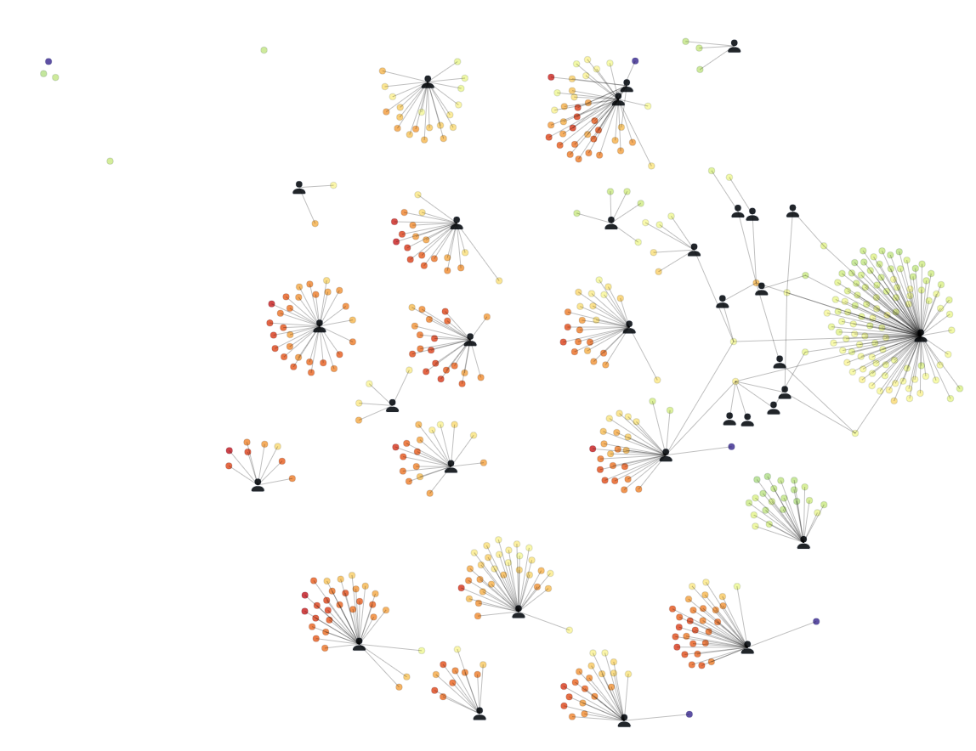

Job Net
Force layouts | PCA
PCA
Color by CPU1 Temperature

